Slide 1

A survival Guide to Python From Zero to Hero
Soheb Mandhai

Slide 2
Disclaimer
This session acts as a reference guide – I’m not a Python wizard by any means, I just have a couple of years of experience with it and am also learning.

Slide 3
Getting Started

Slide 4


What is Python
High-level programming language – A language that can convert an algorithm into a program code without requiring machine-oriented coding.
General purpose – Can be used for websites, automation, data analysis, application creation, machine learning, and more…
Interpreted language - instructions are interpreted line by line without being needing to be compiled

Slide 5
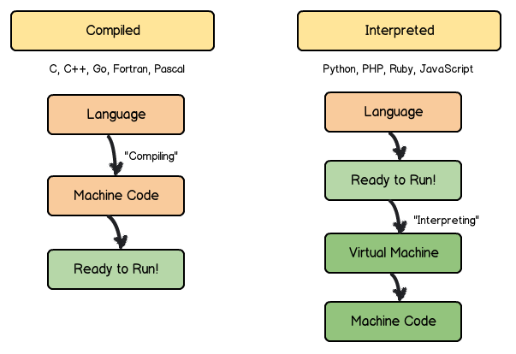
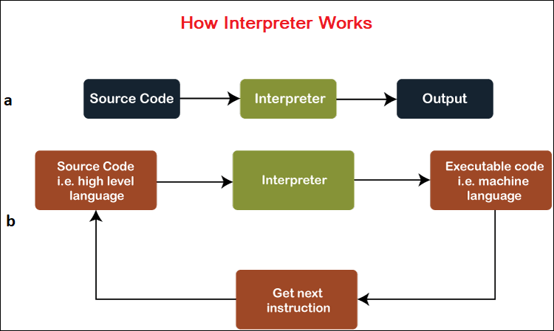
What is an Interpreted Language
Credit: Javatpoint
Credit: Unknown

Slide 6


Installation
Vanilla:
https://www.python.org/
Download > Choose the python version > Pick the appropriate installer for your OS
Note: You will need to install non-standard packages manually
Anaconda (Recommended):
Go to https://www.anaconda.com/products/distribution
Choose the appropriate installation for your OS
Benefit: Comes pre-shipped with most scientific packages, ready to use. Also comes with Spyder IDE.

Slide 7
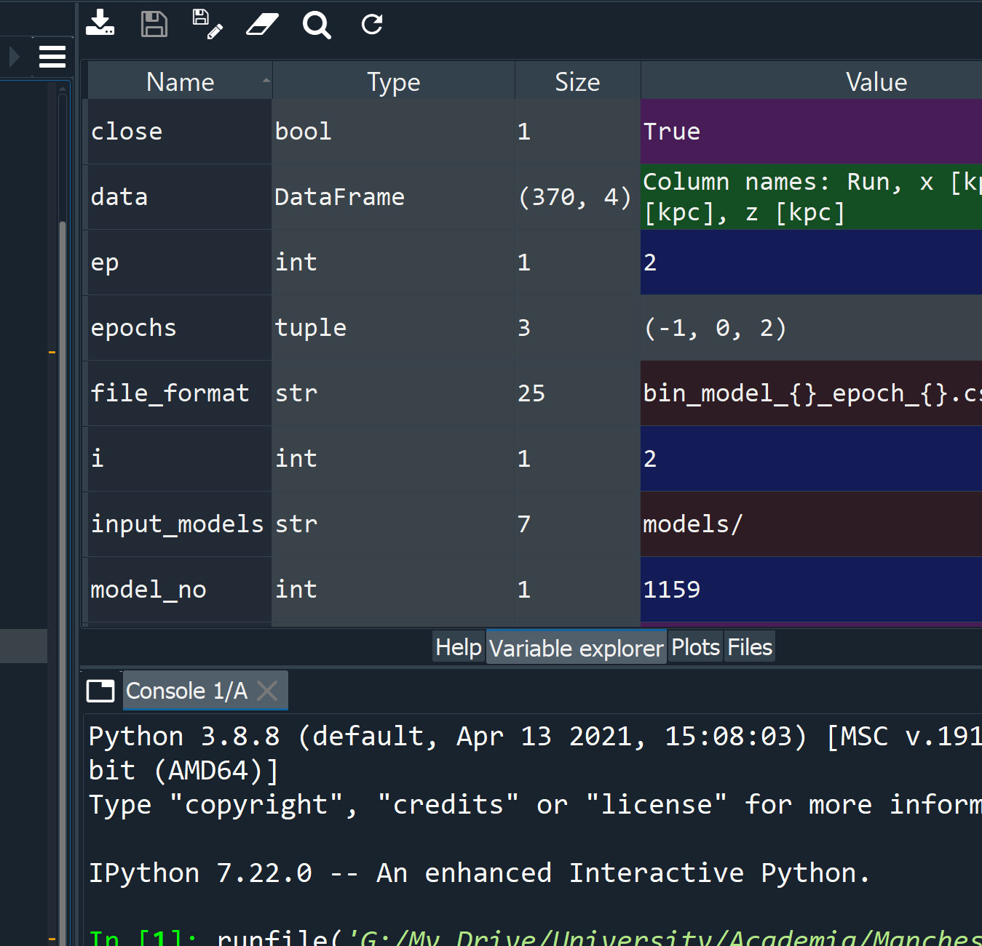
Additional Quick Notes:
Environment Control:
Can create backups of your installed packages
Can create isolated environments to test software
Can be used to minimise bloatware when shipping applications
IDEs – Integrated Development Environments
Excellent for testing
Debugging tools
Useful for managing code and identifying errors/typos early on
Variable display is useful for looking at stored values
Can run multiple instances of a code quickly
Python Script Available Here: https://drive.google.com/file/d/1WXiNCu9LGAA7ljnuDQ88cZBvS8TcGb12/view?usp=sharing

Slide 8
Operators and Data Types

Slide 9


Arithmetic Operators
Reference: w3schools
Operator | Name | Example
+ | Addition | x + y
- | Subtraction | x - y
* | Multiplication | x * y
/ | Division | x / y
% | Modulus | x % y
** | Exponentiation | x ** y
// | Floor division | x // y

Slide 10
Assignment Operators
Reference: w3schools
Operator | Example | Same As
= | x = 5 | x = 5
+= | x += 3 | x = x + 3
-= | x -= 3 | x = x - 3
*= | x *= 3 | x = x * 3
/= | x /= 3 | x = x / 3
%= | x %= 3 | x = x % 3
//= | x //= 3 | x = x // 3
**= | x **= 3 | x = x ** 3
&= | x &= 3 | x = x & 3
|= | x |= 3 | x = x | 3
^= | x ^= 3 | x = x ^ 3
>>= | x >>= 3 | x = x >> 3
<<= | x <<= 3 | x = x << 3
Binary
Operators

Slide 11
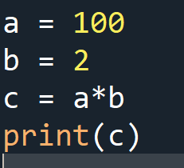
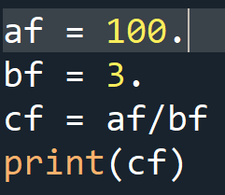
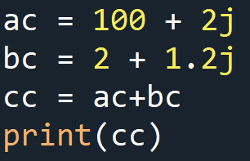
Numerical
Integers
Floats
Complex
Python reference – complex
Examples:
Output: (102+3.2j) Note: ‘j’ is used to denote complex numbers
Python reference – int
Examples:
Output: 200
Python reference – float
Examples:
Output: 33.333333333333336
Note: You can operate between different numerical types. The type that requires the largest memory allocation will dominate. Int -> float -> complex
You can convert types using the reference as a function – e.g. int(231.123) becomes 231

Slide 12
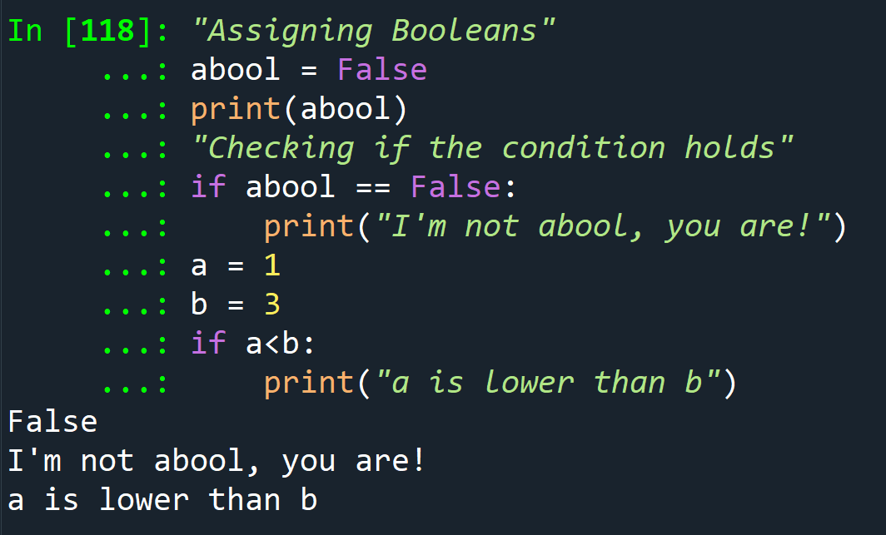
Boolean
True or False
Can be assigned/combined with operators
Commonly used with conditional branching
Python reference – bool
Conditions are covered in later slides

Slide 13
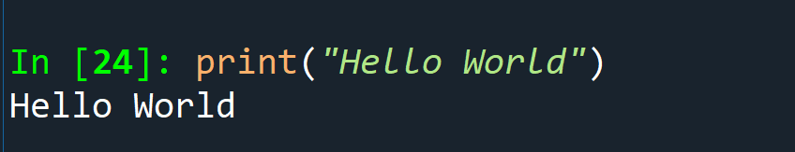
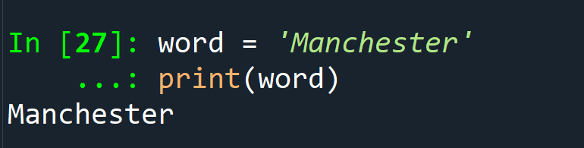
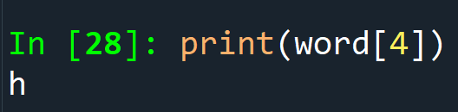
Strings
Chain of characters contained between single or double quotation marks e.g.
You can:
Loop over characters
Obtain the length using len(*string here*)
Apply conditions
Python reference – str
Assigning Strings:
Referring to a character by index – Strings are a sequence of characters:

Slide 14
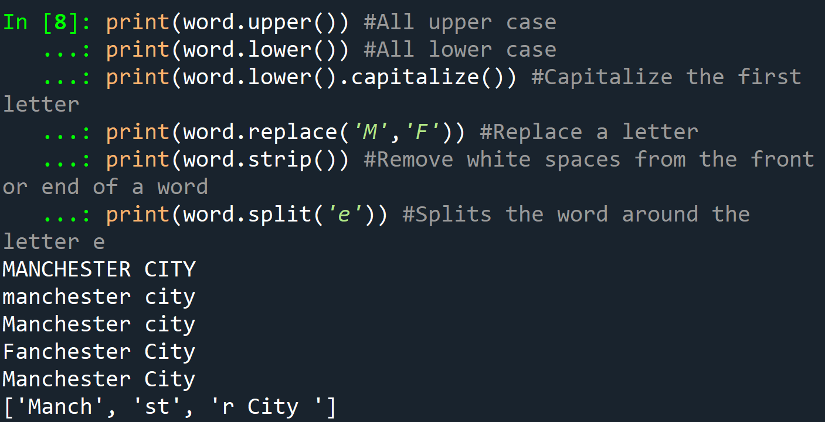
Strings Part 2
You can modify strings using in-built “methods”

Slide 15
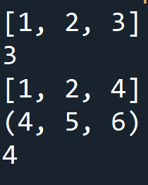
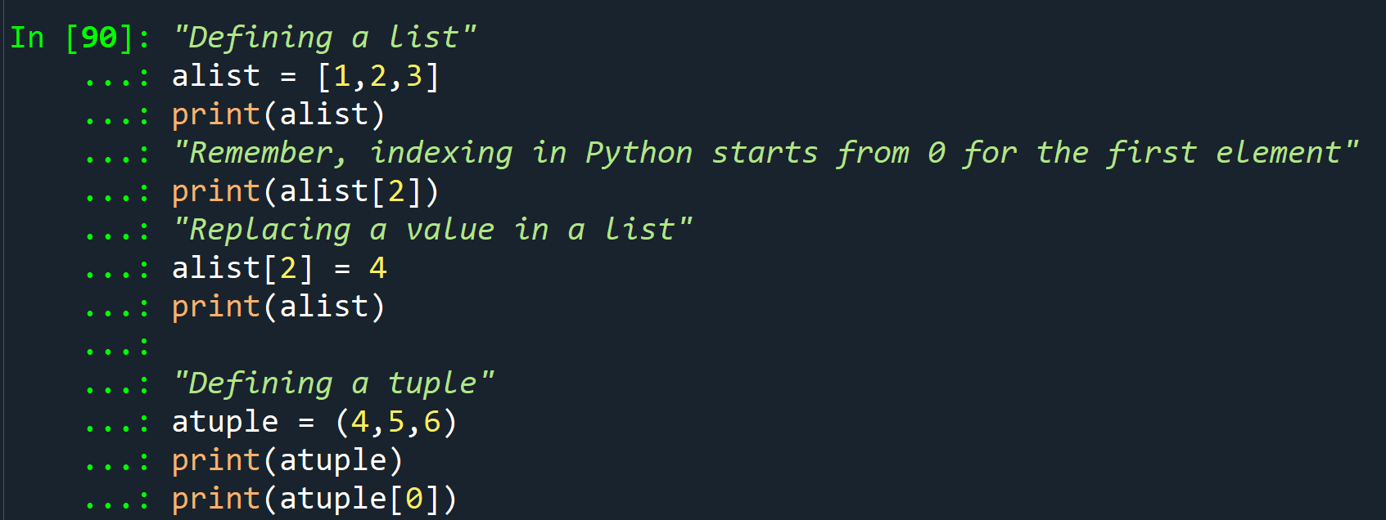
Sequences/Arrays
Both can be iterated over
Remember, indexing stars at 0 for the first element
Allow duplication of entries
Multiplication duplicates the arrays, N times. type(N) == int
Lists
Tuples
Uses square brackets, i.e. []
Are mutable
Cannot be used as keys
Python reference – list
Uses normal brackets, i.e. ()
Are immutable
Can be used as keys
Python reference – tuple

Slide 16
Binary Types

Slide 17
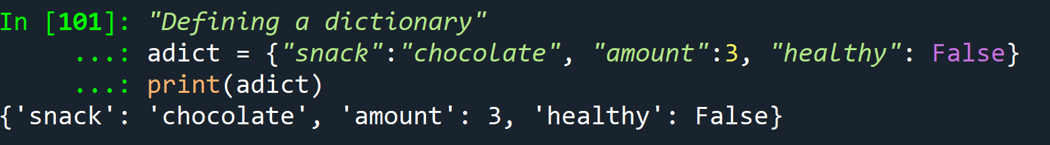
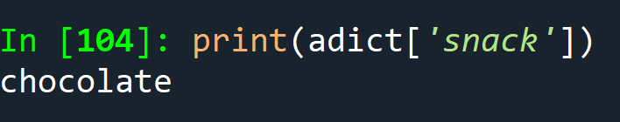
Mapping - Dictionaries
A dictionary is a container that holds values that are accessible using keys.
Python reference – dict
You can retrieve items by referring to keys in a similar manner as indexing
Dictionaries can store multiple data types, including lists, values, and Booleans.
Keys must be unique!
Note: Dictionaries are typically unordered and cannot be referred to with indices (definitely true for Python <3.6 )

Slide 18
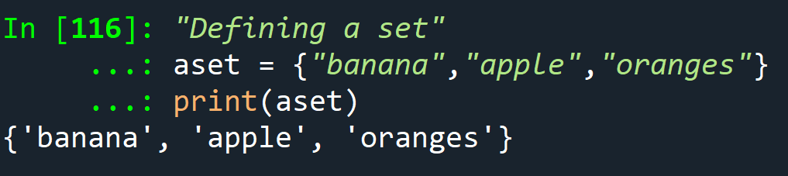
Sets
Sets are like dictionaries but are immutable and don’t require keys.
You cannot have duplicate items in a set
Python reference – set
Can be iterated over
Example:

Slide 19
Exercises
Data type of : int * complex?
I have a dictionary called “fruits”, it looks like this: {'banana': 3, 'strawberries': 4, 'pineapple': 1, 'lemon': 2}
What does “fruits[‘banana’]” output?
I want to get the 3rd element of the dictionary, I use fruits[3] – Why is this wrong?
I have a variable, “food = (“toast”,”cereal”,”croissant”)” –
What does food[1] = “banana” give?
What does (1,2,3)*2 return?

Slide 20
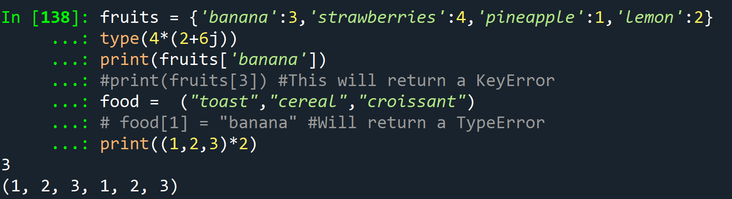
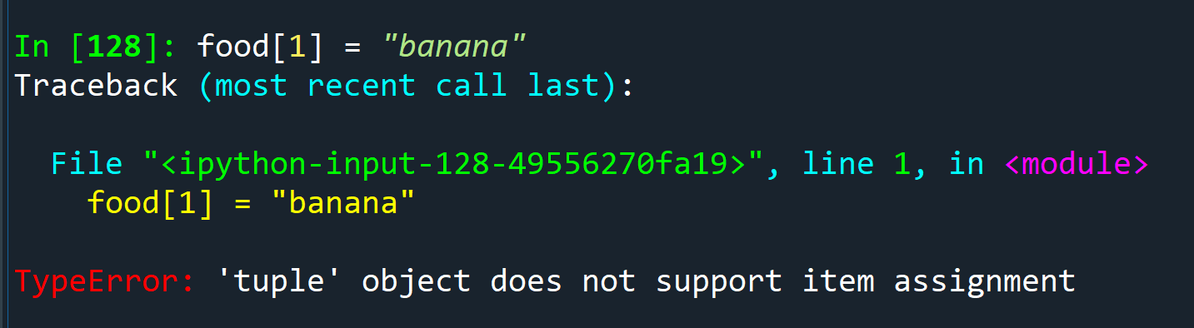
Exercises - answers
Data type of : int * complex? Answer: complex
I have a dictionary called “fruits”, it looks like this: {'banana': 3, 'strawberries': 4, 'pineapple': 1, 'lemon': 2}
What does “fruits[‘banana’]” output? Answer: 3
I want to get the 3rd element of the dictionary, I use fruits[3] – Why is this wrong? Answer: KeyError - dictionaries can’t be indexed + the index would be wrong based on the ordering of the keys
I have a variable, “food = (“toast”,”cereal”,”croissant”)” –
What does food[1] = “banana” give? Answer: TypeError
What does (1,2,3)*2 return? Answer: (1,2,3,1,2,3)

Slide 21
Conditions and Loops

Slide 22
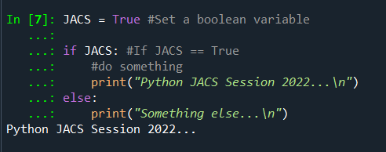
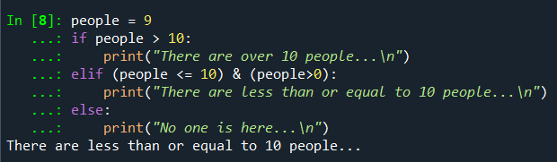
If, Else, ELIF
Using Boolean conditions to activate branches – if and else statements come into play here
You can also use numerical or type checks to activate conditions
Ideally, you want to cover all outcomes with your conditions - this is where elif comes to play (useful for non-binary outcomes)
With Booleans
With a non-Boolean condition
NOTE: From here on out, you’ll need to be mindful of indentations. This is how python chunks code into blocks.

Slide 23
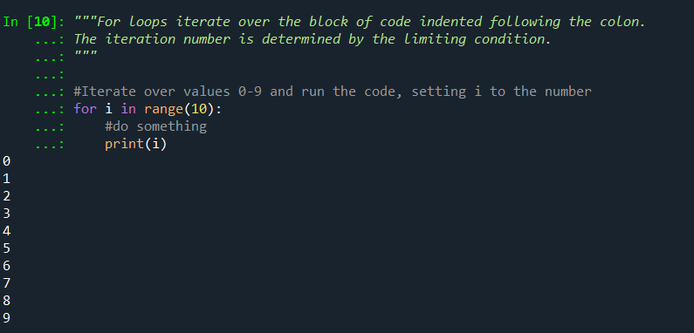
FOR
Iterate over elements in a sequence
Each iteration sets a variable to an element in the sequence
Python reference – for
Example: (range is useful for generating a sequence of numbers)

Slide 24
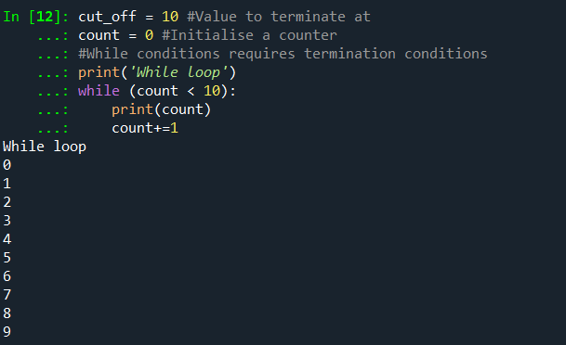
While
Like a for loop but doesn’t rely on a sequence
Uses a termination condition
Python reference – while
Example:
DANGER: If the termination condition is never met, the script will run ad infinitum… or until you run out of memory/turn your computer off.

Slide 25
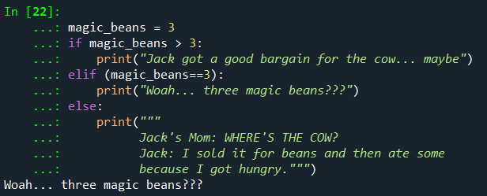

Exercises
Jack goes to a town to sell his cow… He receives a number of beans. Which outcome from the following is triggered if Jack has 3 magic beans?
Look at this while statement… what is the output?

Slide 26

Exercises - Answers
Jack goes to a town to sell his cow… He receives a number of beans. Which outcome from the following is triggered if Jack has 3 magic beans?
Look at this while statement… what is the output?
Please be careful when using while statements…
Especially if using clusters.

Slide 27
Types of Scripting Operations

Slide 28
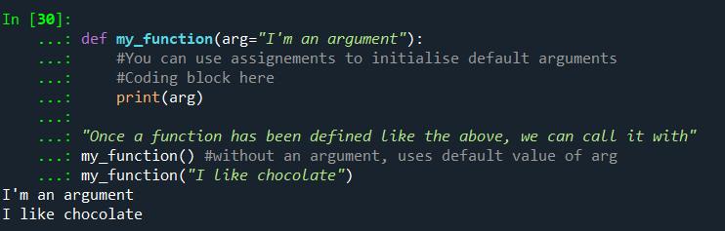
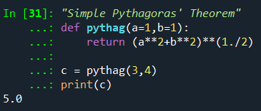
Functions
A function is a block of code that can be reused without repeating lines
You can pass different parameters through functions, these are called “arguments”. Ordering of arguments is important!
You can also assign default values to these, these are called “keyword arguments”:
You can return outputs from a function too

Slide 29

Lambda
A small anonymous function
Can take many arguments but consists of one expression
Useful for mathematical operations
Python reference – lambda
Example:

Slide 30
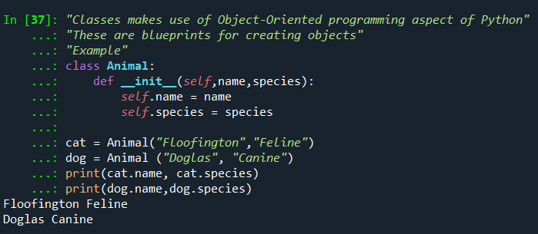
Classes
Makes use of Object-Oriented programming methods
Blueprints for creating objects/instances
Useful for creating complicated registries for subjects
Example:
__init__ is a special “method” to initialise the class
self is used to refer to variables unique to the class “instance”
Create instances of a class
Recalling variables stored in a class

Slide 31

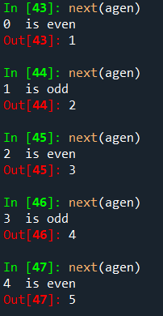
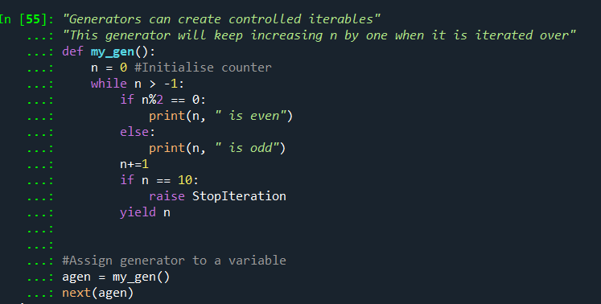
Generators
Useful for controlling iterations over a code block – like a for loop
Uses yield methods
Has special routines
You can use for loops to iterate over generators!
Stopping condition prevents generator from running forever

Slide 32
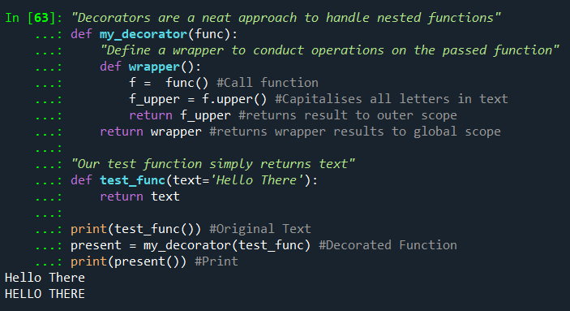
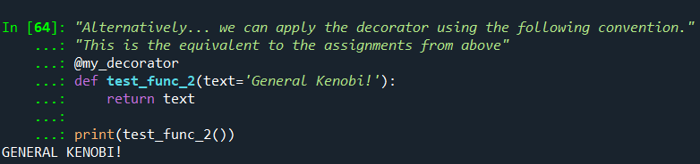
Decorators (BASIC)
An approach to handling nested functions!
A quick way to modify different functions with the same function (wrapper)
A simpler way of wrapping a function!

Slide 33

Exercise
What is the role of “StopIteration” in a generator?
What is the output of:
From this previous example:
What does pythag() return?
What does pythag(b=0) return?

Slide 34
Exercise - Answers
What is the role of “StopIteration” in a generator? Answer: Prevents Generator from iterating over a limit
What is the output of: Answer: 13
From this previous example:
What does pythag() return? Answer: root 2
What does pythag(b=0) return? Answer: 1

Slide 35
Scopes

Slide 36
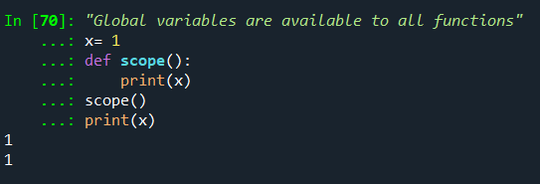
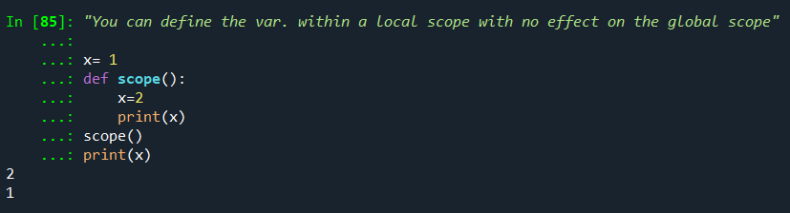
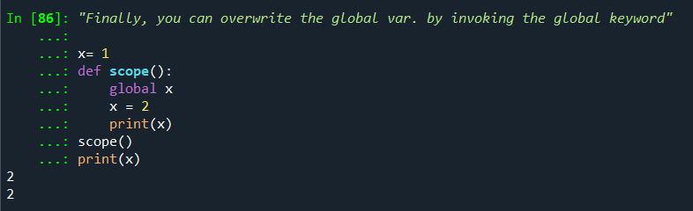
Importance of Scope
Used to describe the access to variables within functions
global variables are accessible to all functions
local variables are accessible within the function/nested functions
You can change variables in the global scope by declaring the variable using the global keyword
Global Access
Local Access
Global Access in Local Scope

Slide 37
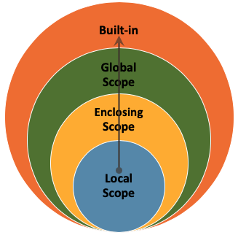
Scope Overview
For nested functions
Credit: Data Camp

Slide 38
Local Scope

Slide 39
Nesting Functions

Slide 40
Exercise

Slide 41
Good Practices

Slide 42
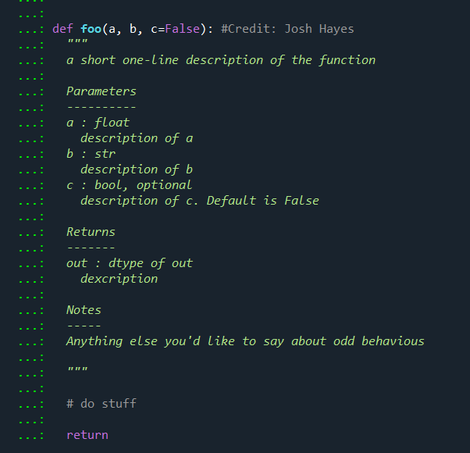
Things to do:
Good Comments:
Commenting your code will make it easier to revisit in the future.
Lets other people understand what you have done.
Makes it easier to identify mistakes in logic
Sensible Variable Names: Give your variables useful names that link back to the context
Documenting your functions: Creating a doc-string will make it easier for you to understand the structure and inputs of your function.
Use ?*function name here* to check docstring

Slide 43
Sensible Variable Naming

Slide 44
Documenting Functions

Slide 45
Common Pitfalls

Slide 46

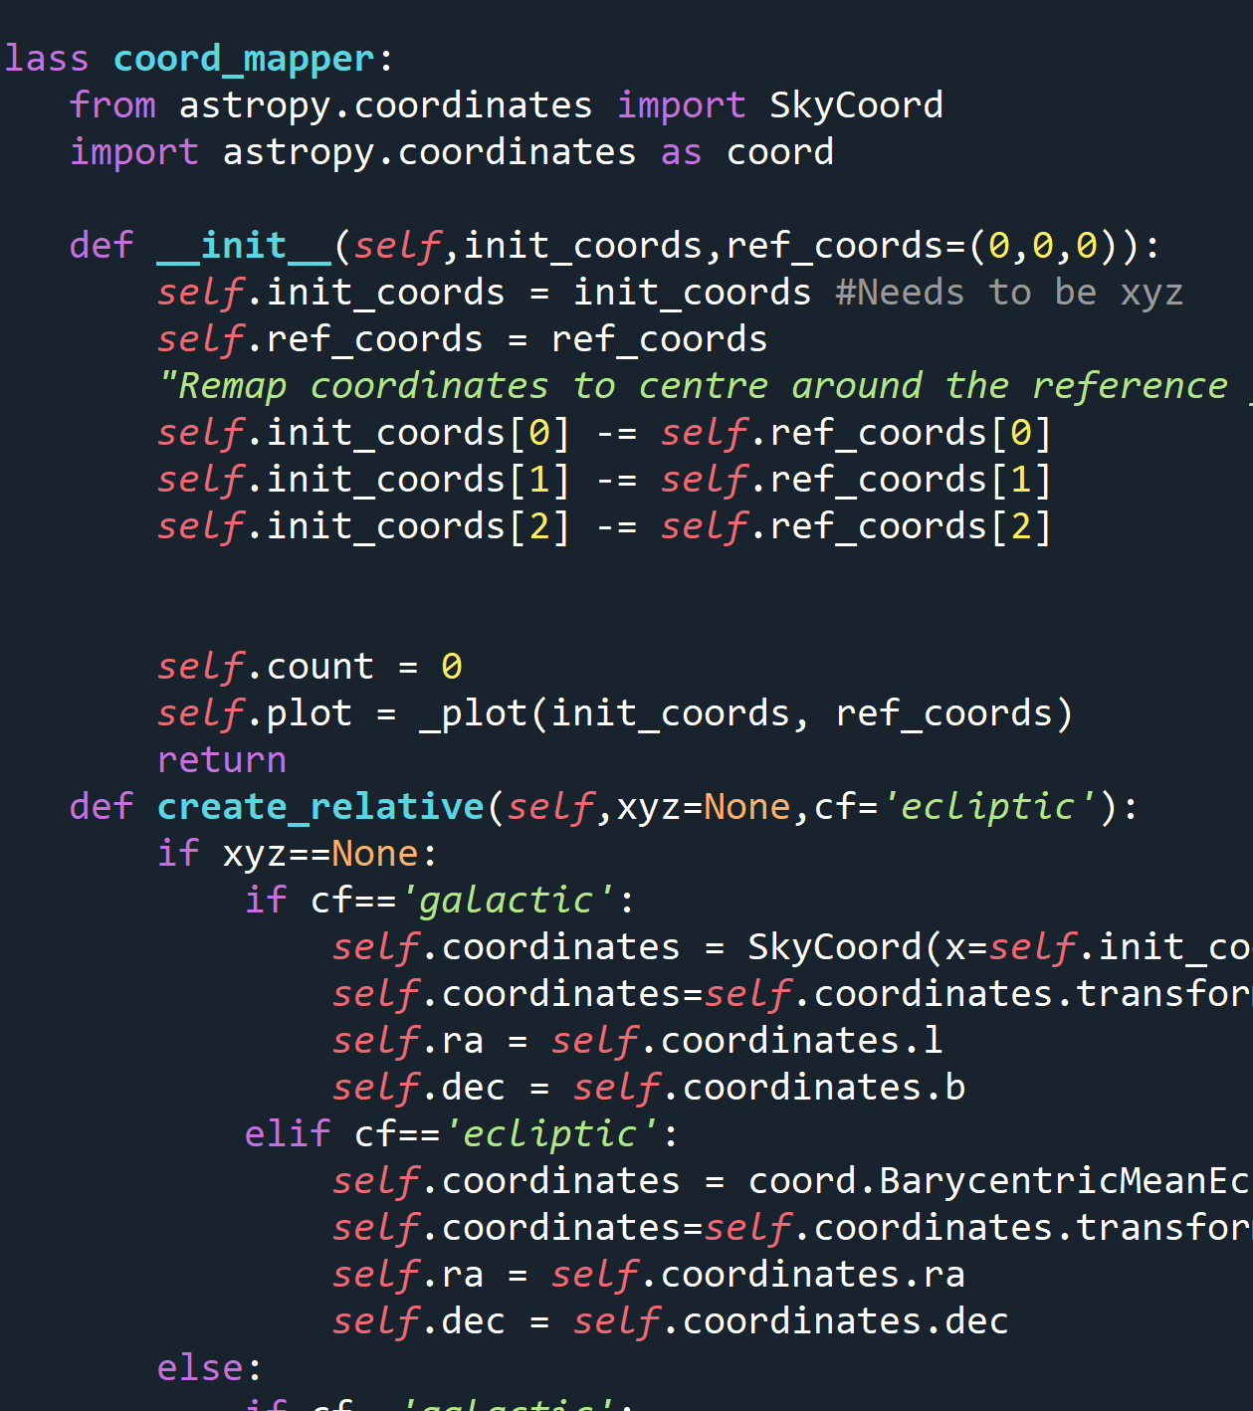
No/Poor Commenting
YES, I’M GUILTY OF THIS
Comment your code:
Helpful if anyone else reads it
Will save you time in the future
“The worst collaborator you can ever have is you from a year ago – they will never answer emails” – Dr. Josh Hayes, 2022

Slide 47
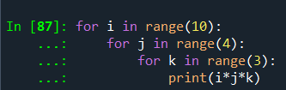
Excessive Looping
YES, I’M GUILTY OF THIS x2
Excessive looping is inefficient and can slow down your code
Some packages like NumPy have routines to avoid looping for mathematical calculations using precompiled C functions.
Itertools and map (uses multiprocessing/threading) are alternatives that can be used if you must have multiple loops

Slide 48
Confusing Variable Names
YES, I’M GUILTY OF THIS x3
Pick sensible names that suit the context of the values contained in the variable.
Bad variable names can cause trouble when debugging/re-reading the code years later.

Slide 49
TIPS

Slide 50

Pseudocode
Write out your algorithm in basic English – create a step by step guide of your logic:
Benefits: This lets anyone translate your algorithm to another programming language if needed
For example, Making Tea – The Algorithm:
Acquire Cup, Tea Bag, Milk, Sugar
Go to Kettle
Check Kettle Water
If water is low:
Refill water
Turn kettle on
Wait
Place Tea Bag in cup with Sugar (NOT MILK – I WILL FIND YOU)
While water == not hot:
Wait
If kettle == done:
water= hot
Pour Water into cup
Stir
Add Milk
Drink

Slide 51






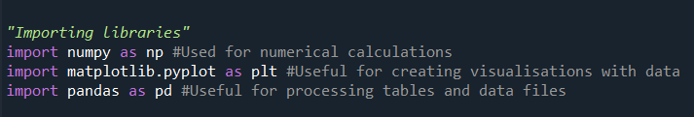
Common Libraries

Slide 52

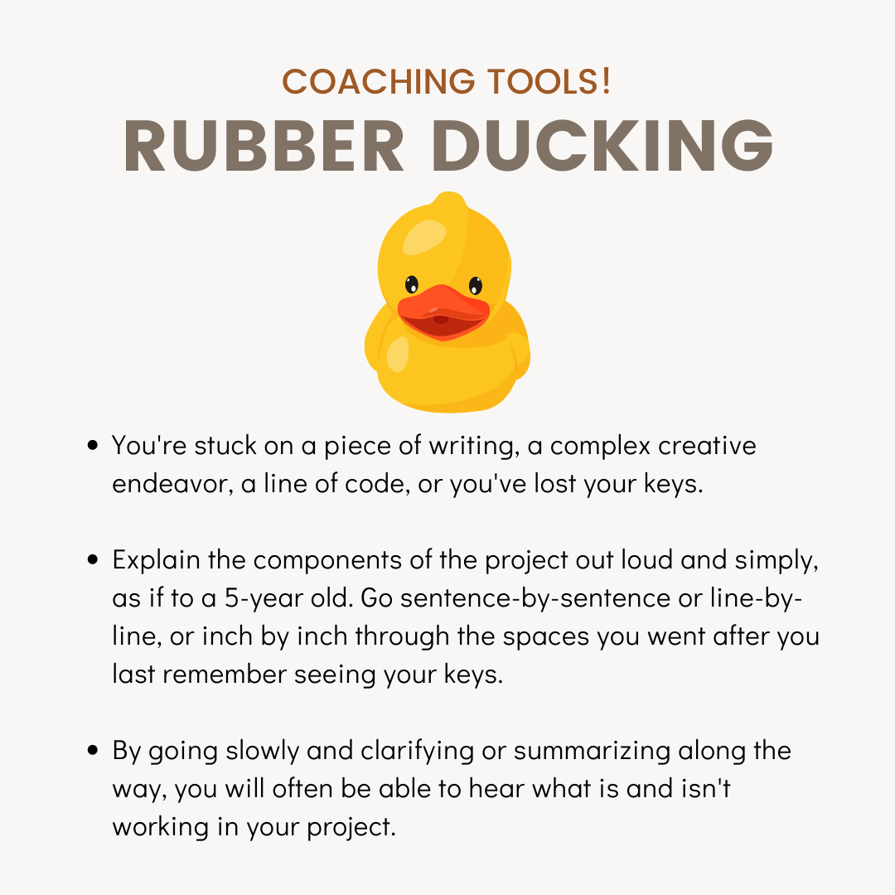
Debugging
Check variable explorer in an IDE to ensure values are what you expect
Narrate your code to a friend or a rubber duck (Rubber Ducking)
Use print statements around offending areas
Follow the traceback
Credit: V & CO Coaching

Slide 53
Traceback
Useful for finding offending snippets of code causing errors
Line of offence is usually given
Error message indicates the nature of the issue
If error is unclear – search documentation for library/function or StackOverFlow

Slide 54
Environment Control

Slide 55
Document

Slide 56
Additional Resources

Slide 57
Need Help?
StackOverFlow
Your Colleagues
W3Schools
Coding Academy
Many More…

Slide 58

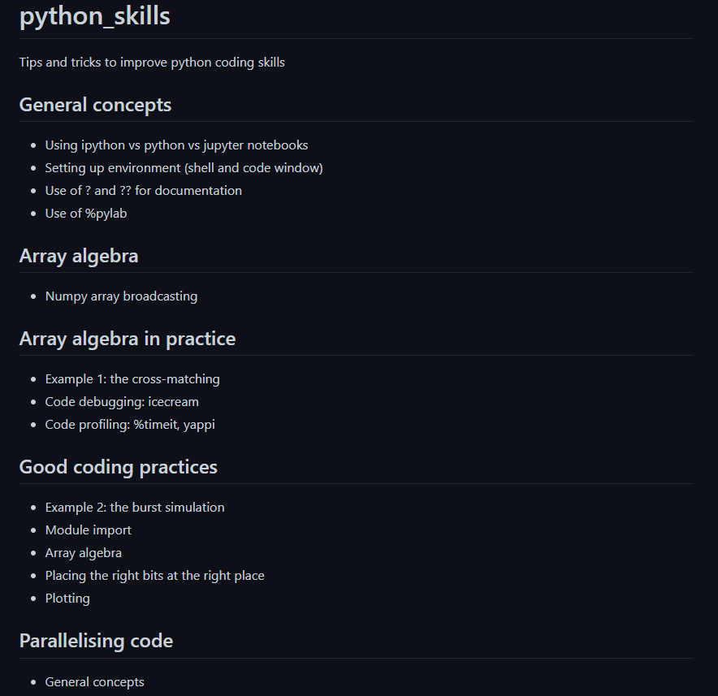
Want to be a Python Jedi?
Check out Rene’s JACS material from previous years - https://github.com/bretonr/python_skills

Slide 59
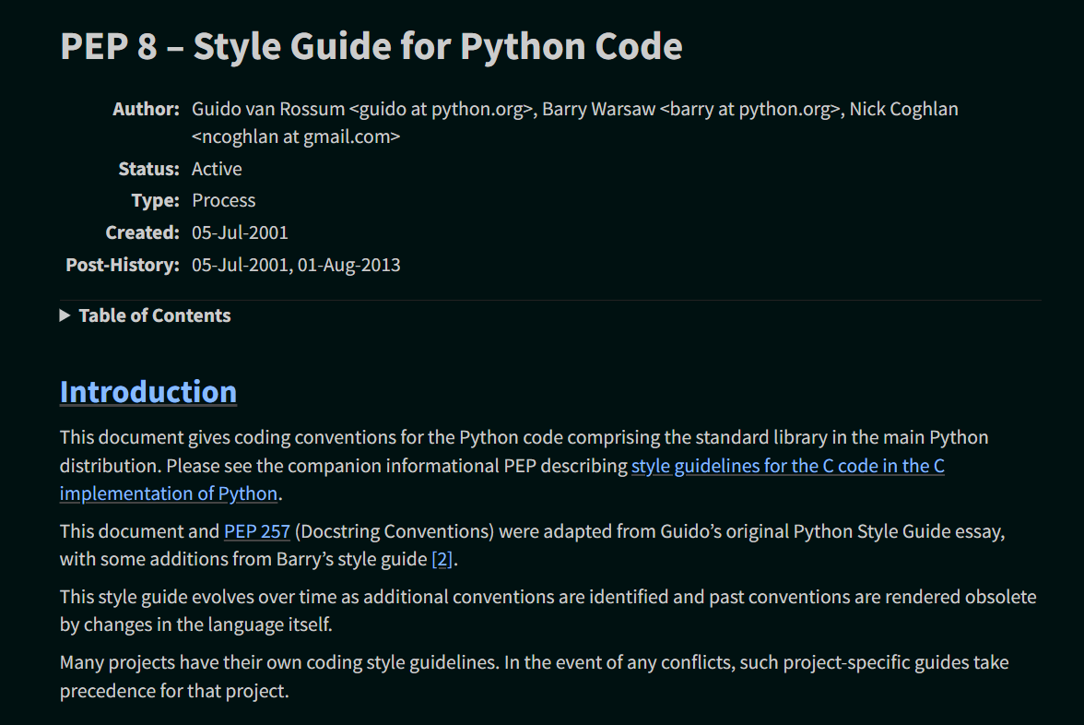
PEP-8 Documentation
Style Guide for Python Code- https://peps.python.org/pep-0008/

